Slide 1

Project name : Delhi air quality forecasting
Team name
Mr. Anil Dodhia
Mr. Shubham Patil
Ms. Prajakta
Mentor Name
Ms. Munmun
Date : 28/02/2021

Slide 2
Business Problem:
To forecast the Delhi air quality
Objective:
The objective of the analysis is to forecast the Delhi air quality for next 24 hours depending on particular matter present in air

Slide 3

Project Architecture / Project Flow
Data preparation
Decode the business problem
Data acquisition/
gathering
Exploratory Data Analysis
(Variable Identification,
Missing values treatment, Variable transformation)
Visualization and communication
Deployment and maintenance
Data modelling
(Arima Model)

Slide 4
Exploratory Data Analysis (EDA) and
Feature Engineering

Slide 5
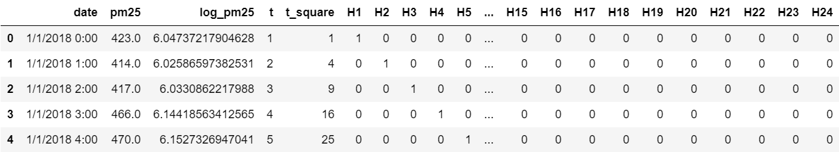
Data set details
Data set :
Rows=2374, columns=29, unique values = 436
Date ranges : 0 to 2373
Missing values : 80

Slide 6
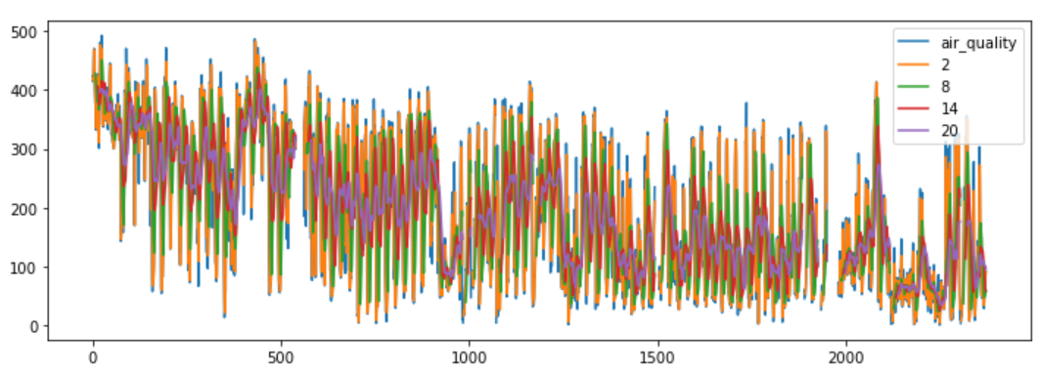
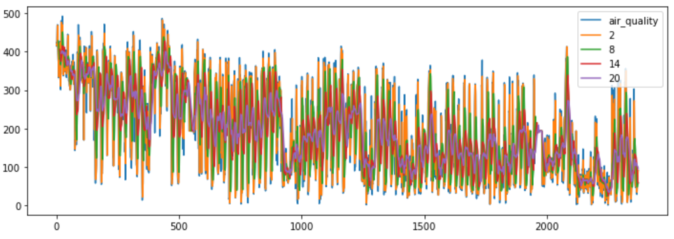
Exploratory Data Analysis (EDA)
Air quality plot with null values present in pm25 variable
Air quality plot without null values present in pm25 variable

Slide 7
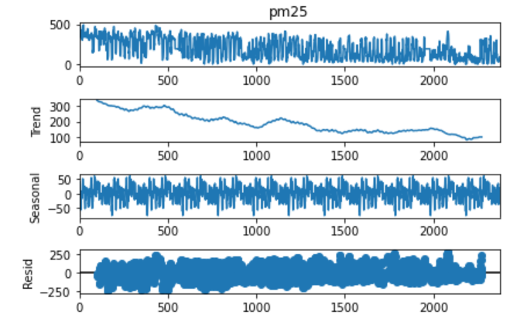
EDA
Time series decomposition plot

Slide 8
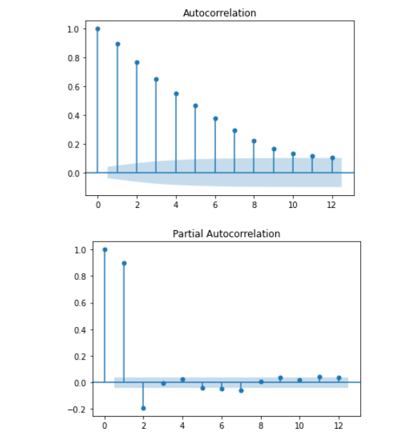
EDA
ACF plots and PACF plots

Slide 9
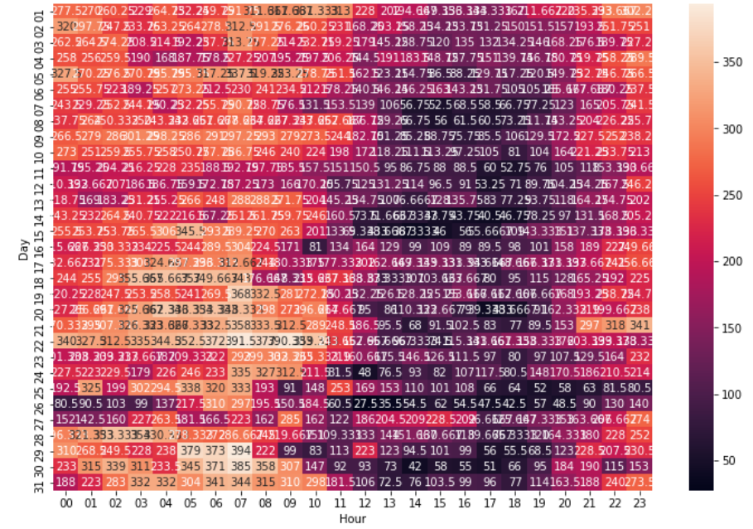
EDA
Correlation matrix or Heatmap plot

Slide 10
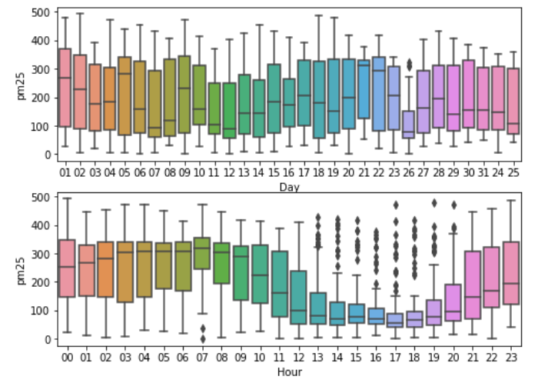
EDA
Box and Whisker plot

Slide 11
Model Building

Slide 12
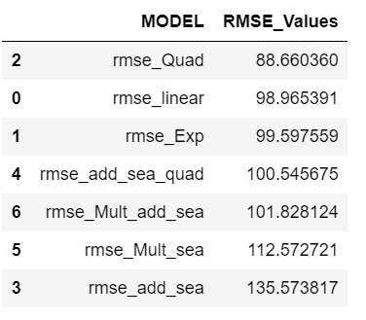
Model results presentation
Model based Validation Method
Data set :
Rows=2374, columns=29, unique values = 436
Date ranges : 0 to 2373
Missing values : 80 (Replaced with Mean value)
Data Partition :
Train data : 1900 (80%)
Test data : 474 (20%)
Model Name : Additive Seasonality
Quadratic
RMSE value : 100.54

Slide 13
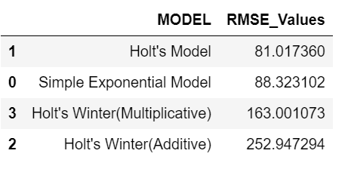
Model results presentation
Data based Validation Method
Data set :
Rows=2374, columns=2, unique values = 436
Date ranges : 0 to 2373
Missing values : 80 (Replaced with Mean value)
Data Partition :
Train data : 2137 (90%)
Test data : 237 (10%)
Model Name : Holts winter
exponential smoothing
Multiplicative seasonality
RMSE value : 163.00

Slide 14
Model results presentation
Arima model
Data set :
Rows=2374, columns=2, unique values = 436
Date ranges : 0 to 2373
Missing values : 80 (Replaced with Mean value)
Data Partition :
Train data : 1900 (80%)
Test data : 474 (20%)
Model Name : Arima
(p,d,q) : (2,1,0)
RMSE value : 86.36

Slide 15
Final Model Selection
By comparing RMSE value related to all the models we decided to go with Arima model as final model for forecasting Delhi air quality for next 24 hours

Slide 16
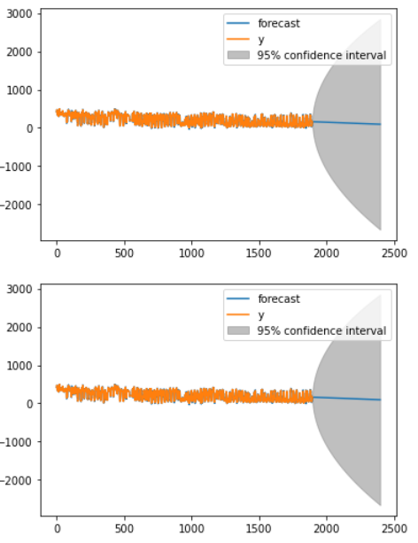
Arima model plot

Slide 17
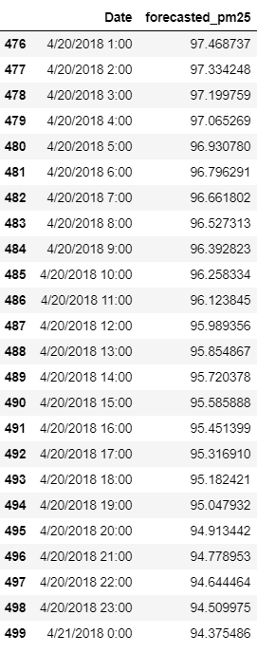
Model Prediction for next 24 hours using Arima model

Slide 18
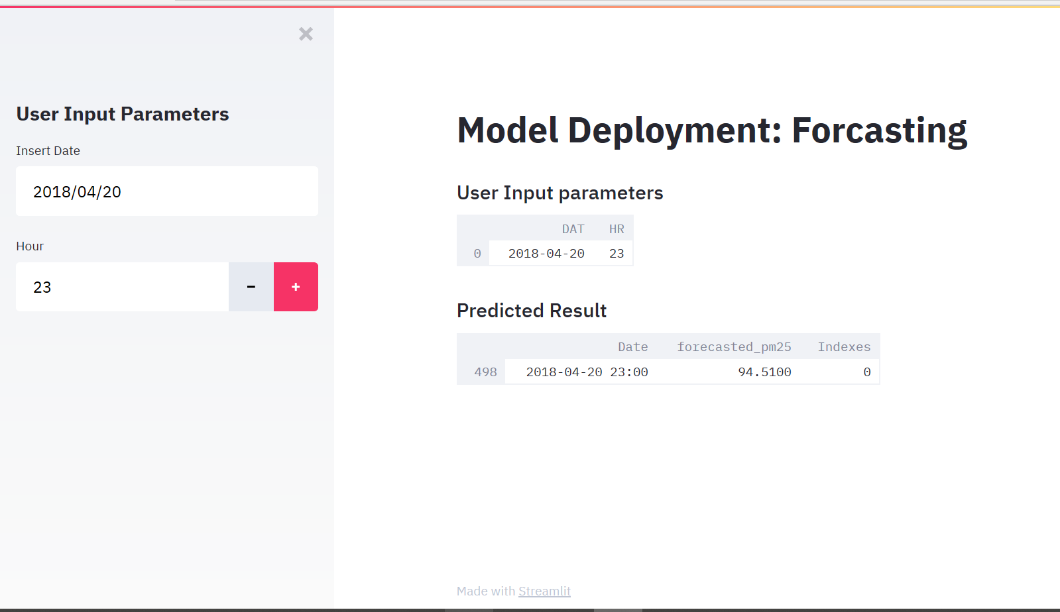
Model Deployment using Streamlit method

Slide 19
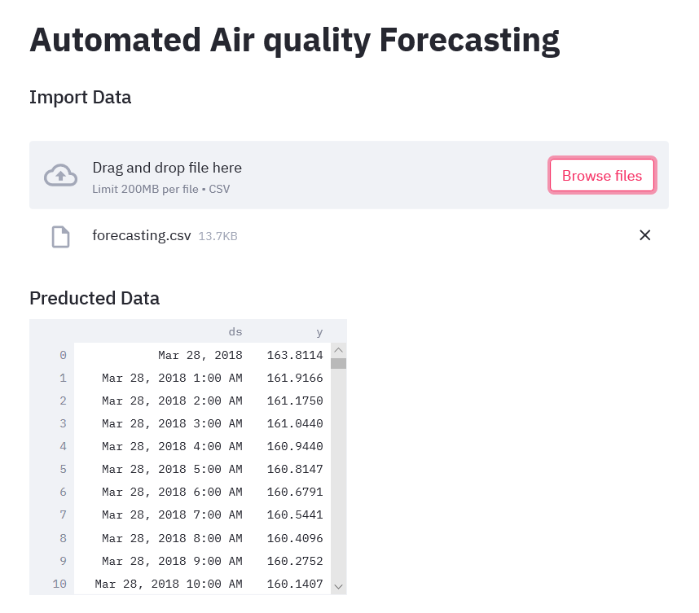
Model Deployment using Streamlit method

Slide 20
Challenges faced?
How did we overcome?
During EDA part we have faced issue related to plotting the series & pyplot due to pm25 variable data type issue.
We have overcome this issue by converting pm25 variable from object to numeric data type.
During Modelling part we have faced challenge related to selecting the Final model due to high RMSE value issue.
We have overcome this issue by selecting final model as Arima model.
During Deployment part we have face issue related to Date type format problem.
We have overcome this issue by changing the date format in both final prediction(csv) file & related source code.

Slide 21
Thank you

